Slide 1
Image Inpainting
105060004 陳彥廷
105060005 王世宇
105060018 謝承儒

Slide 2
Guideline
Target
Effect and details of Image Inpainting
Ways to improve Image Inpainting
Discussion

Slide 3
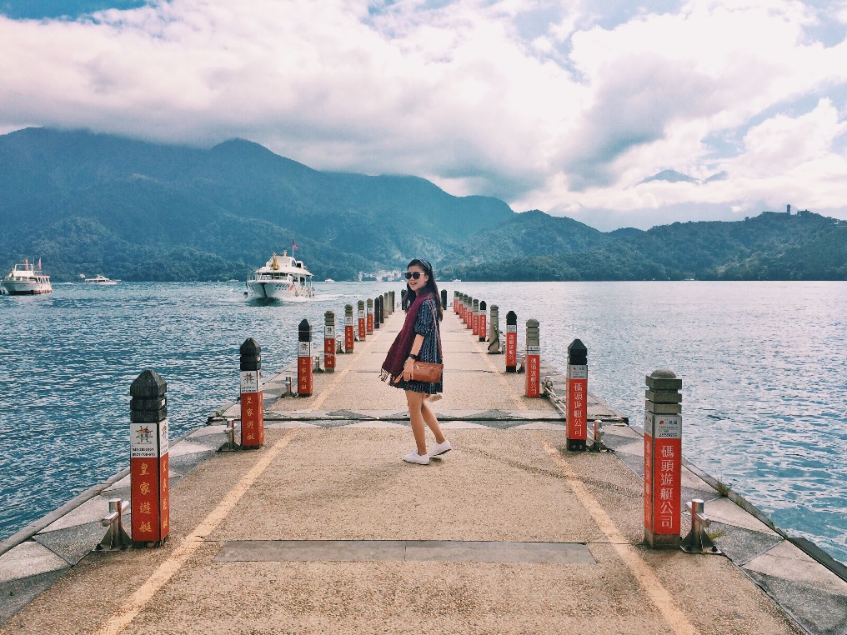
Target
在綺麗的風景前，總會想要留下紀錄，日後就可以看著照片懷念往日的故事。然而這種地方往往是人們爭相前往的所在，因此總會混入許多不相關的人事物，因此我們便想要試著把他們移出照片，並保持圖片的完整。

Slide 4
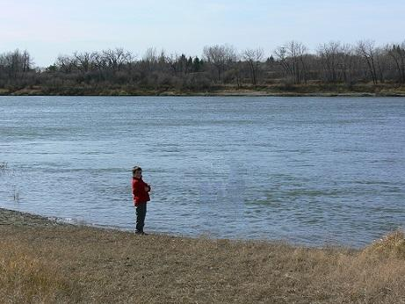
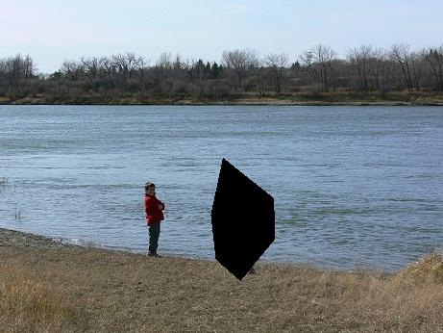
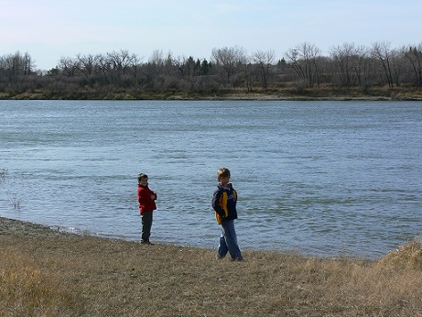
Image Inpainting

Slide 5
Algorism
Including 4 steps:
Users select unwanted objects
Find the most similar area
Fill it back into missing part
Repeat 2. 3. until the mask filled up

Slide 6
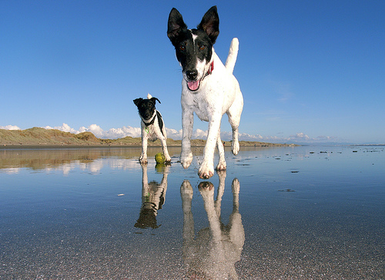
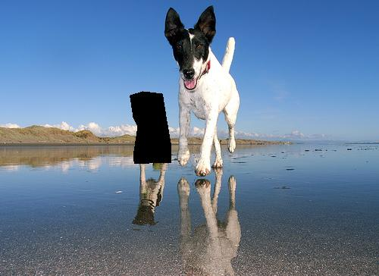
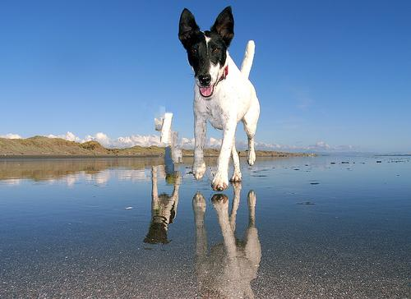
But…

Slide 7
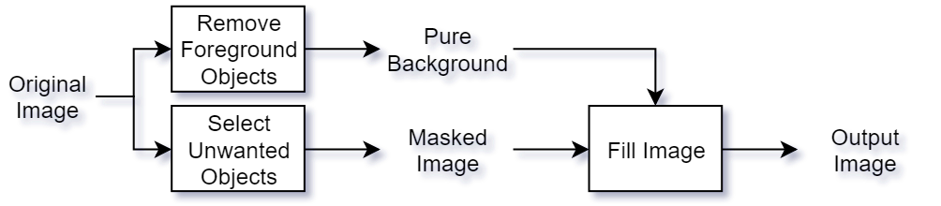
Structure Overview

Slide 8
Improving Methods
To generate pure background, we have tried :
Double Inpainting
Seam Carving

Slide 9


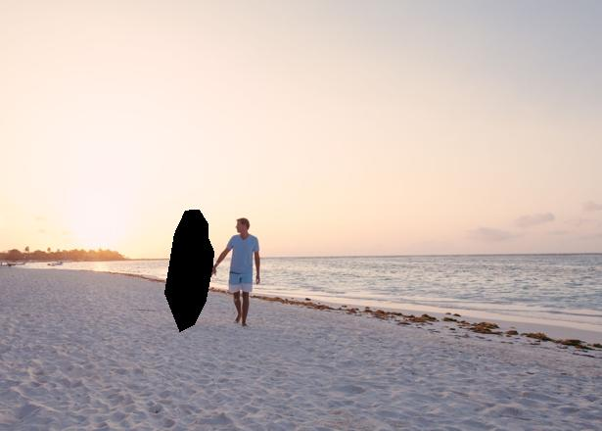
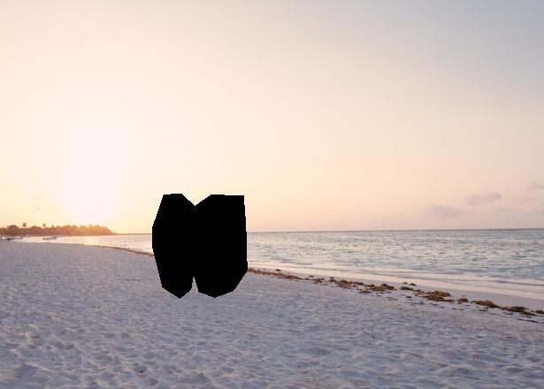

Inpainting Method

Slide 10
Let’s talk about Seam Carving
Algorism overview :
Get energy map ( Grad X + Grad Y )
Accumulate total energy of a seam
Find the lowest energy seam, and remove it
To remove object, we can set the energy of pixels in the mask to –1e5, so that we will remove the seam through the mask first

Slide 11
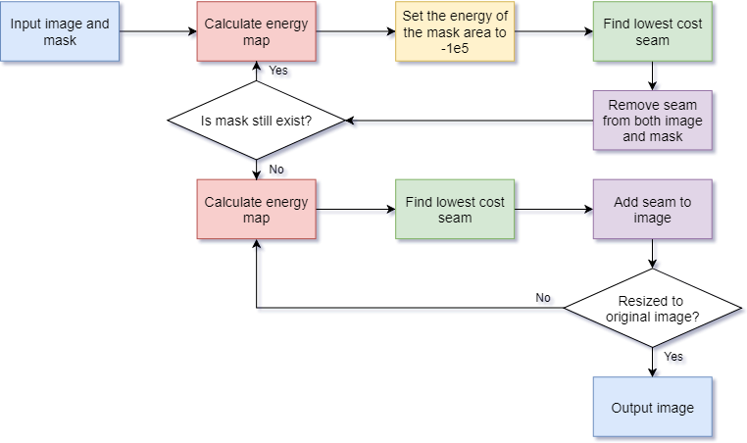
Flowchart

Slide 12

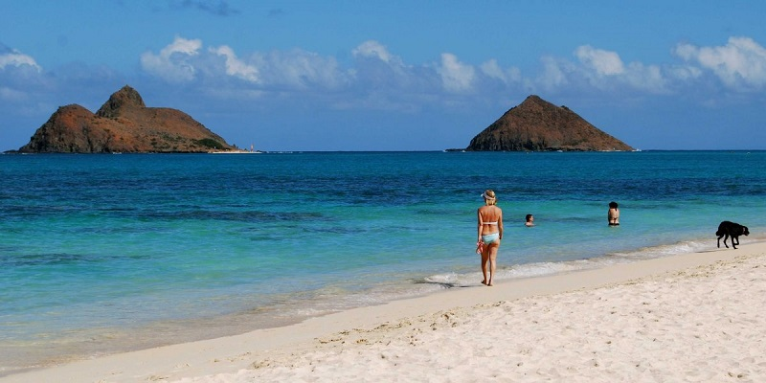


Some Examples

Slide 13
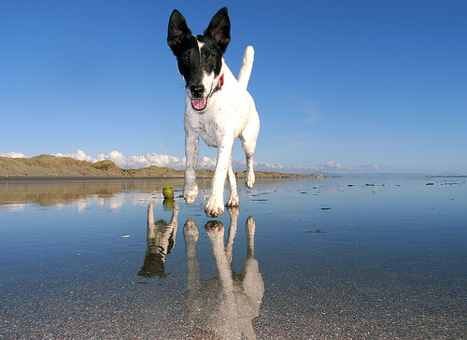
How About This?

Slide 14

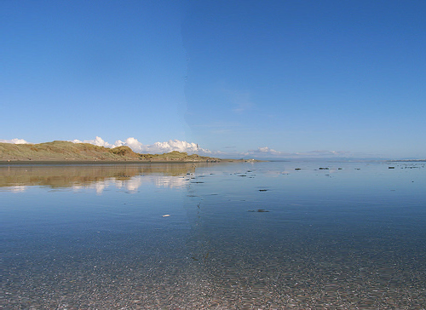
Generated Background

Slide 15

Comparison

Slide 16
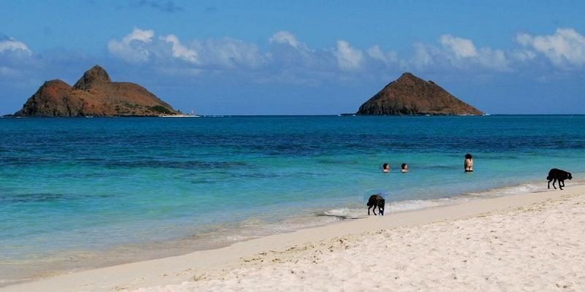
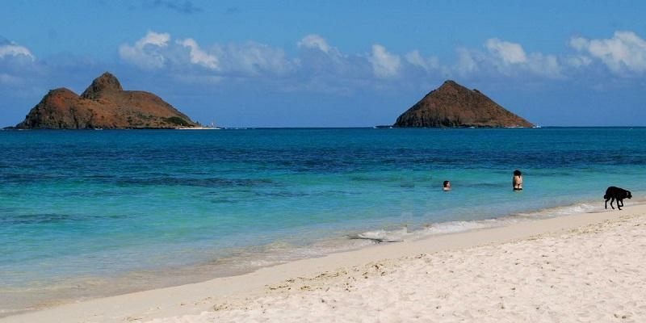
Comparison

Slide 17
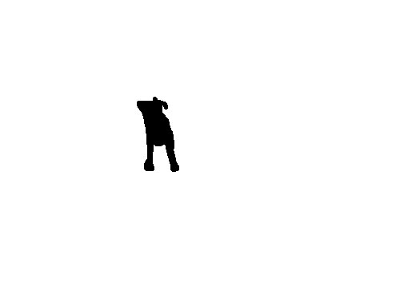

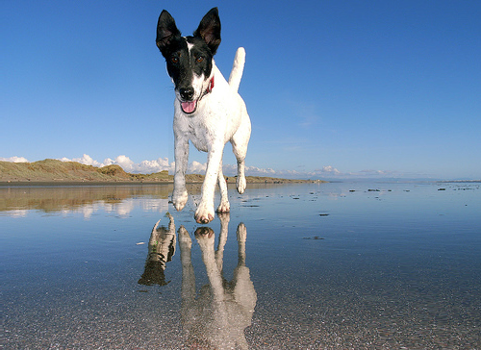
Discussion - Masking

Slide 18
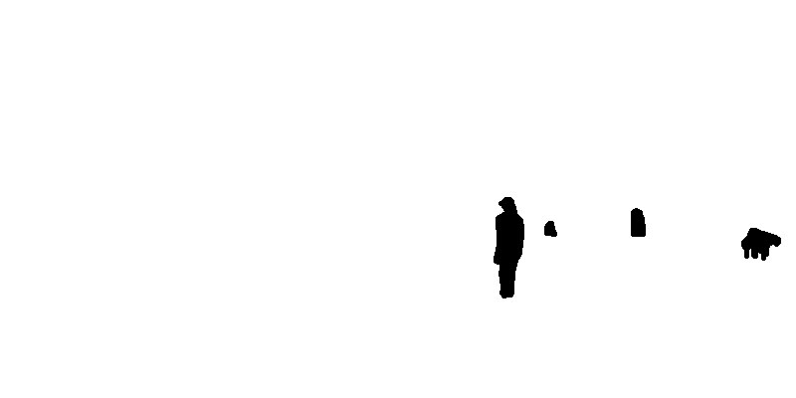


Discussion - Masking

Slide 19
Masking Steps
User sets the mask
Convert the image to gray scale
Smooth image with Gaussian filter ( to reduce noise )
Detect edge by gradient
Only keep the point over the threshold
Box filter convolution
Thresholding again and get the final mask

Slide 20
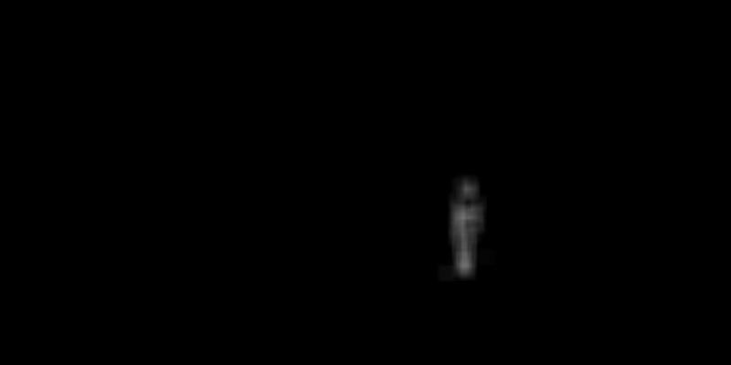

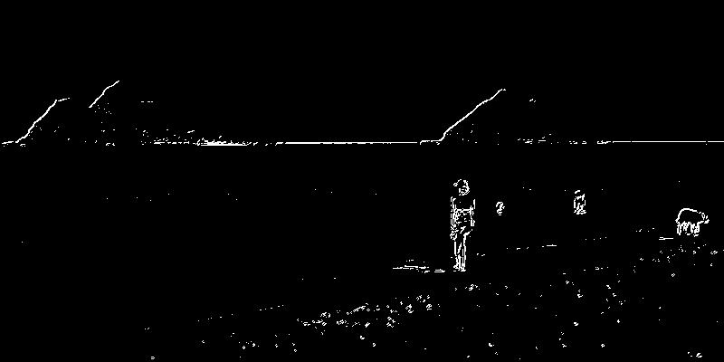

Masking Steps

Slide 21


Comparison
Pixels in the mask
User set : 5430
Calculated : 3524 ( 35% off )
Hand made : 2486 ( 54% off )

Slide 22
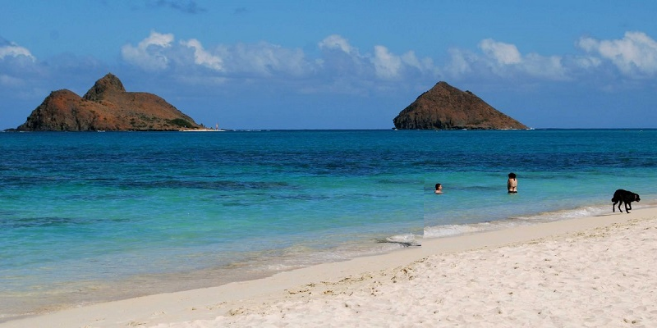
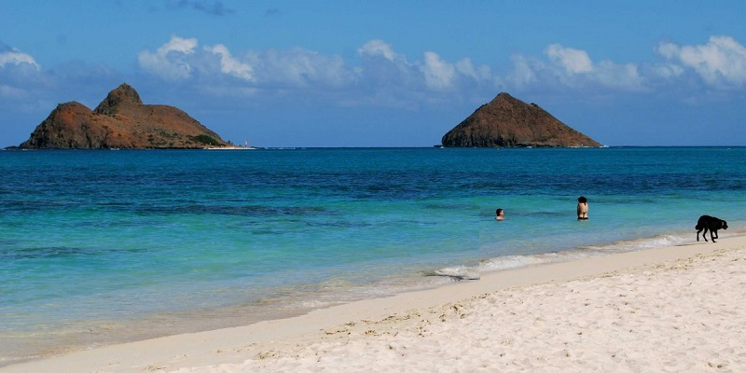
Comparison

Slide 23
Conclusion

